Slide 1
Synonym Distinction
Group 4

Slide 2
Catalogue
01
spur
02
ample

Slide 3
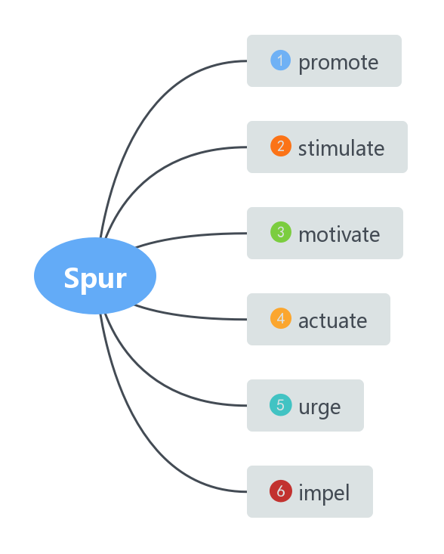
1
spur

Slide 4



Original Meaning
Generalized sense of "anything that urges on, stimulus," is from late 14c. As a sharp projection on the leg of a cock, from 1540s. Meaning "a ridge projecting off a mountain mass" is recorded from 1650s. Of railway lines from 1837. "Widely extended senses ... are characteristic of a horsey race" [Weekley]. Expression on the spur of the moment (1801) preserves archaic phrase on the spur "in great haste" (1520s). To win one's spurs is to gain knighthood by some valorous act, gilded spurs being the distinctive mark of a knight.
Old English spura, spora "metal implement worn on the heel to goad a horse" (related to spurnan "to kick"), from Proto-Germanic *spuron (source also of Old Norse spori, Middle Dutch spore, Dutch spoor, Old High German sporo, German Sporn "spur"), from PIE *spere- "ankle" (see spurn). Related to Dutch spoor, Old English spor "track, footprint, trace."

Slide 5
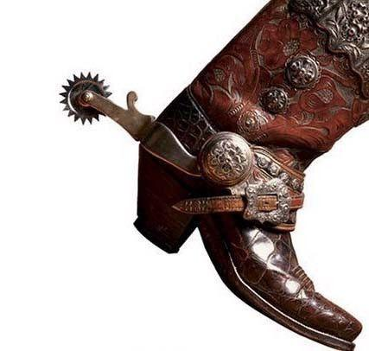
spur
noun.
a sharp pointed object that riders sometimes wear on the heels of their boots and use to encourage their horse to go faster.

Slide 6
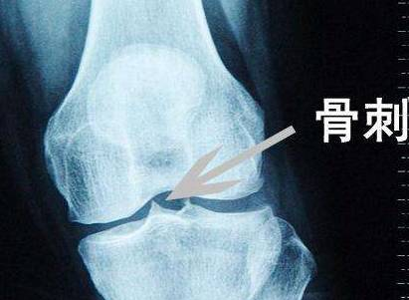
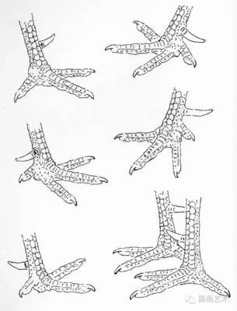
词义进化角度一：形状像马刺
a short branch road or railway line
an area of high ground that sticks out from a mountain or hill
支线
尖坡
马刺
（医学）骨刺
（公鸡的）距
挂果的
短侧枝
a short fruit-bearing side shoot

Slide 7
词义进化角度二：马刺的作用——激励
v. urge a horse forward by digging one’s spurs into its sides
引申为踢马刺策马前进的动作
e.g. She spurred her horse towards the hedge.
1
v./n. 激励，鞭策encourage somebody
e.g. Her difficult childhood spurred her on to succeed.
2
3
v. 促进某事发生To encourage an activity or development
e.g. The agreement is essential to spurring economic growth around the world.

Slide 8
词义进化角度三：踢马刺给马的感觉——一股冲动
n. (短语) on the spur of the moment 凭一时冲动
e.g. Impulsively
Without prior preparation, he decided to join a tour to England on the spur of the moment.

Slide 9
promote
late 14c., "to advance (someone) to a higher grade or office," from Old French promoter and directly from Latin promotus, past participle of promovere "move forward, advance; cause to advance, push onward; bring to light, reveal," from pro "forward" (see pro-) + movere "to move" (from PIE root *meue- "to push away"). General sense of "to further the growth or progress of (anything)" is from 1510s.

Slide 10
Root
1.促进
e.g. The agreement is essential to promoting economic growth around the world.
2. 晋升
e.g. I was promoted to editor and then editorial director.
3. 促销，推广
e.g. The band has gone on tour to promote their new album.
pro- 向前
词根promote （motion）运动
向前运动 -> 推动，促进

Slide 11
stimulate
1610s, "rouse to action," from Latin stimulatus, past participle of stimulare.

Slide 12
Original Meaning
v. If something stimulates a part of a person's body, it causes it to move or start working. 刺激 (身体器官)
adj. the stimulating effect of adrenaline 肾上腺素的刺激作用
1
2
3
stick
sting
stimulate
原始人类为了御敌，会把棍子的一头削尖
通过刺、戳、叮来刺激

Slide 13
Figurative Meaning
v. (对抽象对象的)刺激，促进To encourage something to grow, develop, or
become active.
e.g. The agreement is essential to stimulating economic growth around the world.
1
2
v. (对人的)激励To make someone excited and interested about something.
e.g. He was stimulated by the challenge.

Slide 14
Quiz
A
Q1，Exercise ______ the digestive and excretory systems.
A
B
stimulates
spurs
B
Q2，The area is being ______ as a tourist destination.
A
B
stimulated
promoted

Slide 15
Other
Synonyms

Slide 16
motivate
1863, "to stimulate toward action, act as the inciting cause of," from motive + -ate (2); perhaps modeled on French motiver or German motivieren.
Root：motivate

Slide 17
Actuate
Example
To make a machine work or be the reason a person acts in a certain way.
A detonator is actuated by heat, percussion, friction, or electricity.
He was actuated almost entirely by altruism

Slide 18
Root
Actuate
act-
Act
+
= 'be acted'
-ate
passive suffix

Slide 19
Urge
Example
To strongly advise or try to persuade someone to do a particular thing.
To encourage someone strongly to do something or to ask that something be done.
Party leaders urged her to run for Congress.
verb
verb
noun
A strong wish, especially one that is difficult or impossible to control:
Publishers urge authors to produce new editions because it helps with the promotion of the title.

Slide 20
Impel
Example
To make someone feel that they must do something.
I wonder what it is that impels him to exercise all the time.
She was in such a mess I felt impelled to (= felt I had to) offer your services.

Slide 21
Etymology
impel
early 15c., from Latin impellere "to push, strike against, drive forward, urge on," from assimilated form of in- "into, in, on, upon" + pellere "to push, drive" .
Related
impelled; impelling

Slide 22
Ample
Full & Replete
Synonyms

Slide 23
Ample
“great, abundant,” especially “sufficient for any purpose,” from Old French ample “large, wide, vast, great”, from Latin amplus “large, spacious; abundant, numerous; magnificent, distinguished,” which is related to ampla “handle, grip; opportunity,” from Proto-Italic *amlo“seizable”.
“伟大的，丰富的”，特别是“足以用于任何目的”，来自古法语的ample“大的，宽的，广的，伟大的”，来自拉丁语的amplus “大的，宽敞的；丰富的，众多的；宏伟的，杰出的”；与ampla的“把手，把手；机会”有关，来自原始意大利语系的amlo“可占领的;可没收的;可捉捕的;可夺取的”。

Slide 24
Ample
Original meaning:
1 . more than enough
足够的，充足的，充裕的
•You'll have ample opportunity to ask questions after the talk.
演讲结束后你们会有足够的时间提问。
•They had ample warning of the factory closure.
对于工厂的倒闭，他们早就得到了大量警告。
Extended meaning:
2 . If the shape of someone's body or a part of their body is ample, it is large.（fat）
•His ample girth (= his big stomach) was clear evidence of his passion for food. 从他那大腹便便的样子一眼就能看出，他是个非常好吃的人。

Slide 25
Full adj.
Old English full "containing all that can be received; having eaten or drunk to repletion; filled; perfect, entire, utter," from Proto-Germanic *fullaz "full" (source also of Old Saxon full, Old Frisian ful, Dutch vol, Old High German fol, German voll, Old Norse fullr, Gothic fulls).
古英语full“包含所有可以接受的东西；吃过或喝过以饱足；充满的；完美的，完整的，完全的，”来自原始日耳曼语*fullaz (义同full)(也来源于古撒克逊语全称，古弗里斯语full，荷兰语utter，古高德语vol，德语fol，古挪威语fullr，哥特式fulls )。

Slide 26
Original meaning :
1. (of a container or a space) holding or containing as much as possible or a lot
（容器或空间）装满的，充满的
•This cup is very full so be careful with it.
这个杯子太满了，要当心。
•My plate was already full.
我的盘子已经满了。
2. containing a lot of things or people or a lot of something
充满…的；有很多…的
•His essay was full of spelling errors.
他的论文里满是拼写错误。
• be full of yourself
自以为是

Slide 27

Full
Extended meaning:
1. complete, whole, or containing a lot of detail
完整的；全部的；整个的
•Please give your full name and address.
请提供你的全名和地址。
2. the greatest possible
最大的；最大量的；最高级的
•James is very bright, but he doesn't make full use of his abilities.
詹姆斯非常聪明，但他并没有充分发挥自己的才能。

Slide 28
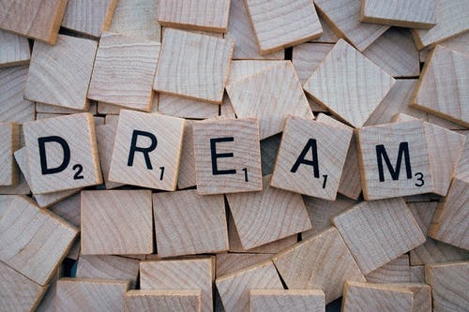
Replete
from Old French replet (filled up), from Latin repletus (filled, full)
源于旧法语replet（filled），源于拉丁语repletus（filled，full）

Slide 29

Replete
Original meaning:
1. full, especially with food.
充满的，装满的；（尤指）饱食的
•After two helpings of dessert, Sergio was at last replete.
吃了两份甜点，塞尔吉奥终于饱了。
Extended meaning:
1 . well supplied
供应充分的；完备的
This car has an engine replete with the latest technology.
这辆车的发动机 应用了最新技术。

Slide 30

FULL implies the presence or inclusion of everything that is wanted or required by something or that can be held, contained, or attained by it.
• a full schedule
AMPLE implies having a greater size, expanse, or amount than that deemed adequate.
• ample closet space
REPLETE implies being filled to the brim or to satiety.
• replete with delightful details

Slide 31
Quiz
ample
• There's _______ room for another desk in the reception area.
ample
• "Will $500 be enough spending money?" "That will be ________."
full
• The shelves were _______ of books.
• When she looked at him her eyes were _______ of tears.
full
replete
• literature _______ with drama and excitement.
replete
• The Harbor was _______ with boats.

Slide 32
Thank you
for your listening

